Slide 1
Create your own Automation tool
Unix based tool built with bash shell and ansible & python
This Automation tool can be used to automate day to day various Unix tasks. This tool can make Unix Administrators work easy, efficient and fast.
Provide great ability to server admin to reduce manual efforts significantly
This tool comprises of various scripts like Shell Scripting, Ansible & python etc.
This tool work over SSH

Slide 2
Create your own Automation tool
This tool is compatible with various operating systems like all flavor of Linux, HP-UX and Solaris.
There are multiple scripts are working in behind of this tool to make an easy going and valuable results.

Slide 3
Create your own Automation tool
Concept of this Automation Tool
This tool is using various shell scripts (Around 50-60 Scripts), which are integrated with Ansible to make it fully automated.
Ansible is a radically simple IT automation platform that makes your applications and systems easier to deploy.

Slide 4
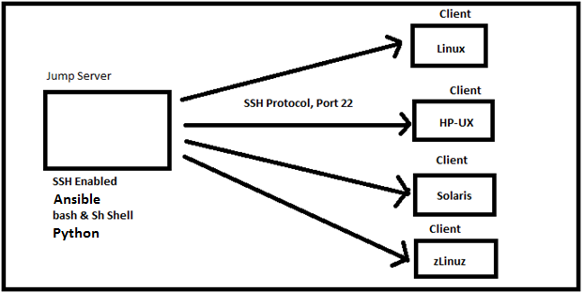
Create your own Automation tool
Concept of this Automation Tool

Slide 5
Create your own Automation tool
Communication between Ansible Server with managed hosts
Normal user would be used for communication between Control node & managed hosts.
Normal user would be used to perform with various tasks but for few tasks like user administration, where it requires an administrative privilege then Ansible provides a feature which can be used to elevate the privilege from normal to root user using sudo access.

Slide 6
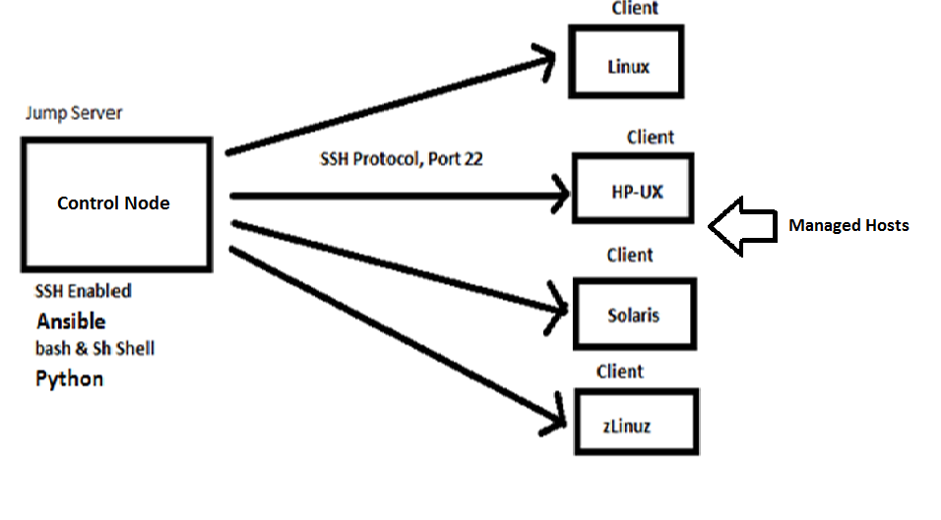
Create your own Automation tool
Communication between Ansible Server with managed hosts

Slide 7
Create your own Automation tool
Prerequisites:
One Jump Server is required, where we can place scripts of UXadmTool and from where all the Unix Servers are accessible via SSH Protocol (port 22).
Ansible should only be installed on control host from where we should control all the hosts.
There should a normal user account whose access should be working on all the servers with sudo to root access with password because we need a user account who will be running this tool.

Slide 8
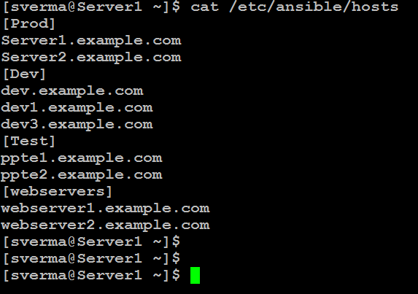
Create your own Automation tool
Maintaining a inventory file for list of managed hosts (Clients)

Slide 9
Create your own Automation tool
Front look of Automation Tool

Slide 10
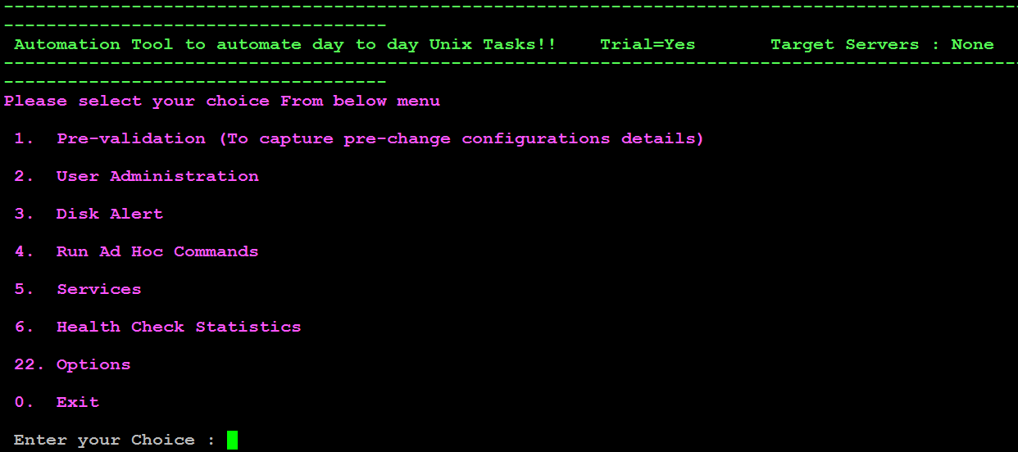
Create your own Automation tool

Slide 11
Create your own Automation tool
What we are achieving from this Automation tool.
Pre-validation Configuration (To capture pre-change configuration details)
Pre-Implementation task is basically collecting the output all the possible commands from the various servers (HP-UX, Linux, Solaris) and put it in a save location which can be used further as troubleshooting if any failure comes during the implementation or post-implementation task.

Slide 12
Create your own Automation tool
What we are achieving from this Automation tool.
Pre-validation Configuration (To capture pre-change configuration details)
Most of the accounts receiving huge number of request for Patching, reboot etc. on multiple Servers and Unix Team needs to spend lots of time to work as Pre-implementation task, which we usually do it before doing any major task on the server like patching or reboot etc.
Pre-Implementation Scripts are capturing the below commands output from the servers:
It is fetching various commands output as shown below : OS Version, Model, IP Address, Serial Number, Asset Number, Environment, App/Db Running, Datacenter, Enclosure Name, Console Details

Slide 13
Create your own Automation tool
What we are achieving from this Automation tool.
Faulty Disk Alert
This Automation is used for tracing the Faulty Boot Disk (HP-UX/Linux Servers only). Basically motive of this automation is “prevention is better then cure” .

Slide 14
Create your own Automation tool
What we are achieving from this Automation tool.
Faulty Disk Alert
This Automation can be used to check the Disk failure logs/Faulty Disk/Stale Lvols/Umirroed Root Volumes and if found any issues related with Boot disk then it will automatically drop a Alert mail to the Unix team DL and also will create some files which we can check manually on the server for more information.
We had run it on many Servers on many environment and found some discrepancies like few servers were running with single OS disk etc. or faulty boot disk etc. So we had immediately remediate it to avoid any future escalations.
To run the script, just copy it to any server and run it manually or via schedule cron job.

Slide 15
Create your own Automation tool
What we are achieving from this Automation tool.
User Administration
1. User Creation
2. User Removal
3. Group Add
4. Password Reset
5. Add Entry in Sudoers file

Slide 16
Create your own Automation tool
What we are achieving from this Automation tool.
User Administration
User Creation:
This Automation can be used for the user creation on multiple servers in one go and it would be very beneficial because we usually get many tickets on user account related like Unix User, DB User, Application User etc. User Removal tasks for UNIX Servers.
User Removal:
This option can be used to remove the user’s account from the mentioned servers

Slide 17
Create your own Automation tool
What we are achieving from this Automation tool.
User Administration
Passowrd Reset
We can reset the password on multiple servers parallelly.
We are using python to generate SHA512 password in crypted form to keep all security measures.
Group Add
We can add group on multiple servers parallelly.
Add Entry in Sudoers file

Slide 18
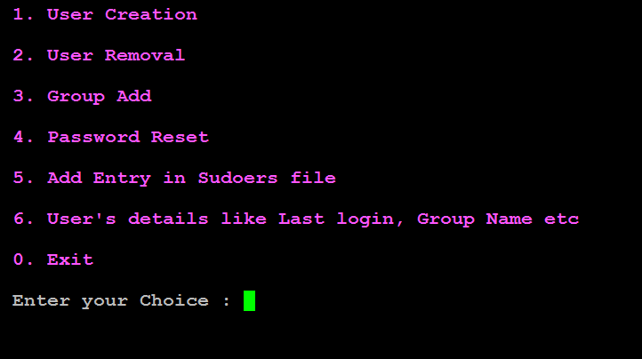
Create your own Automation tool
What we are achieving from this Automation tool.
User Administration

Slide 19
Create your own Automation tool
What we are achieving from this Automation tool.
Run Ad Hoc Command
We can run any ad hoc command on multiple servers parallelly and get the desired output.

Slide 20
Create your own Automation tool
What we are achieving from this Automation tool.
Health Check Statistics
This option is basically provides real time data from "N" of servers like
1. Memory Utilization
2. CPU Utilization
3. Overall I/O Activities
4. Reports run queue and load average on the server
and many more

Slide 21
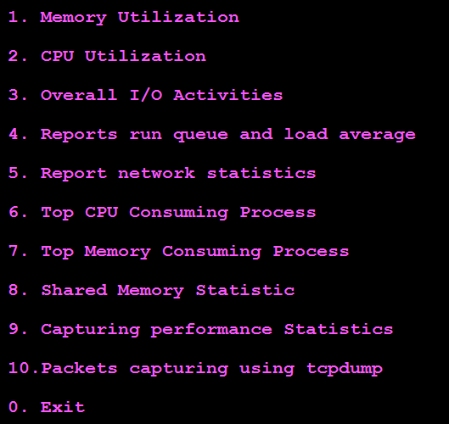
Create your own Automation tool
What we are achieving from this Automation tool.
Health Check Statistics

Slide 22
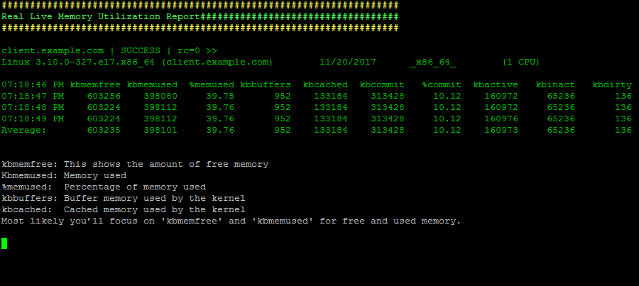
Create your own Automation tool
Memory Utilization

Slide 23
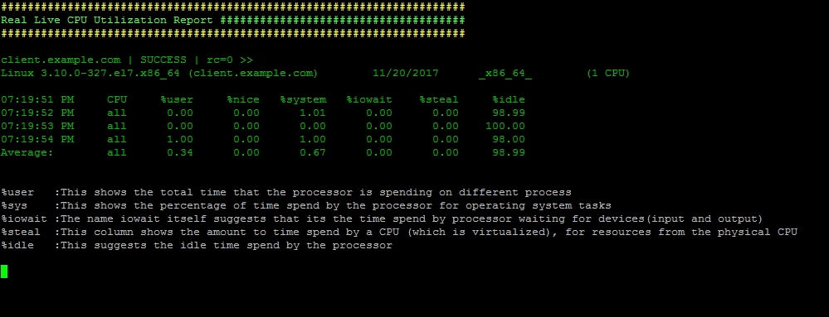
Create your own Automation tool
CPU Utilization

Slide 24
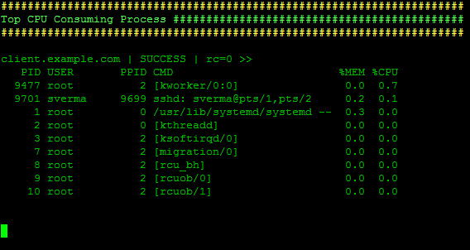
Create your own Automation tool
Top CPU Consuming processes

Slide 25
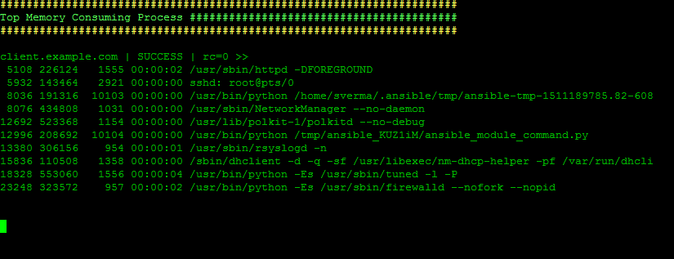
Create your own Automation tool
Top Memory Consuming processes

Slide 26
Create your own Automation tool
Top Memory Consuming processes

Slide 27
Create your own Automation tool
What we are achieving from this Automation tool.
Services
We can check the status of any service and also we can perform the start stop enable of any service on desired servers.

Slide 28
Create your own Automation tool
What is required to Create this simple & useful tool
Shell Scripting
If..else..elif statement
Loops
Sed – Stream Editot
Awk
The case esac statement

Slide 29
Create your own Automation tool
What is required to Create this simple & useful tool
Ansible
Ansible concepts and architecture
Role and requirements for the control node
Role and requirements for the managed hosts
Communication between Ansible Server with managed hosts
Ansible inventories
Deploying Ansible
Ad Hoc Commands
Implementing playbooks

Slide 30
Create your own Automation tool
Shell Scripting
The if...else statements
we will understand shell decision-making in Unix. While writing a shell script, there may be a situation when you need to adopt one path out of the given two paths. So you need to make use of conditional statements that allow your program to make correct decisions and perform the right actions.
Unix Shell supports conditional statements which are used to perform different actions based on different conditions. We will now understand two decision-making statements here
Syntax
if...fi statement
if...else...fi statement
if...elif...else...fi statement

Slide 31
Create your own Automation tool
Shell Scripting
The if...else statements
Syntax
if command
then
command executed successfully
execute all commands up to else statement
or to fi if there is no else statement
else
command failed so
execute all commands up to fi
fi

Slide 32
Create your own Automation tool
Shell Scripting
Loops
Most languages have the concept of loops: If we want to repeat a task twenty times, we don't want to have to type in the code twenty times, with maybe a slight change each time.
As a result, we have for and while loops in the Bourne shell. This is somewhat fewer features than other languages, but nobody claimed that shell programming has the power of C.
Method 1
for varname in list
do
command1
command2
..
done

Slide 33
Create your own Automation tool
Shell Scripting
Loops
Method 2: Bash For Loop using C like syntax
The second form of the for loop is similar to the for loop in “C” programming language, which has three expressions (initialization, condition and updation).
for (( expr1; expr2; expr3 ))
do
command1
command2
..
done

Slide 34
Create your own Automation tool
Shell Scripting
Sed Command in Unix and Linux
Sed is a Stream Editor used for modifying the files in unix (or linux). Whenever you want to make changes to the file automatically, sed comes in handy to do this. Most people never learn its power; they just simply use sed to replace text. You can do many things apart from replacing text with sed. Here I will describe the features of sed with examples.
SED is a powerful text stream editor. Can do insertion, deletion, search and replace(substitution).
SED command in unix supports regular expression which allows it perform complex pattern matching.
Syntax
sed OPTIONS... [SCRIPT] [INPUTFILE...]

Slide 35
Create your own Automation tool
Shell Scripting
Awk Introduction and Printing Operations
Awk is a programming language which allows easy manipulation of structured data and the generation of formatted reports. Awk stands for the names of its authors “Aho, Weinberger, and Kernighan”
The Awk is mostly used for pattern scanning and processing. It searches one or more files to see if they contain lines that matches with the specified patterns and then perform associated actions.

Slide 36
Create your own Automation tool
Shell Scripting
Awk Introduction and Printing Operations
Some of the key features of Awk are:
Awk views a text file as records and fields.
Like common programming language, Awk has variables, conditionals and loops
Awk has arithmetic and string operators.
Awk can generate formatted reports

Slide 37
Create your own Automation tool
Shell Scripting
Awk Introduction and Printing Operations
Syntax:
awk '/search pattern1/ {Actions}
/search pattern2/ {Actions}' file

Slide 38
Create your own Automation tool
Shell Scripting
The case statement
The case statement is good alternative to multilevel if-then-else-fi statement. It enable you to match several values against one variable. It is easier to read and write.

Slide 39
Create your own Automation tool
The syntax is as follows:
case $variable-name in
pattern1)
command1
...
....
commandN
;;
pattern2)
command1
...
....
commandN
;;
patternN)
command1
...
....
commandN
;;
*)
esac

Slide 40
Create your own Automation tool
The case statement
The case statement allows you to easily check pattern (conditions) and then process a command-line if that condition evaluates to true.
In other words the $variable-name is compared against the patterns until a match is found.
*) acts as default and it is executed if no match is found.
You must include ;; at the end of each commandN. The shell executes all the statements up to the two semicolons that are next to each other.
The esac is always required to indicate end of case statement.

Slide 41
Create your own Automation tool
#!/bin/sh
echo "Please talk to me ..."
while :
do
read INPUT_STRING
case $INPUT_STRING in
hello)
echo "Hello yourself!"
;;
bye)
echo "See you again!"
break
;;
*)
echo "Sorry, I don't understand"
;;
esac
done
echo
echo "That's all folks!"

Slide 42
Create your own Automation tool
Ansible
What is Ansible?
Ansible is an open source configuration management and orchestration utility (planning or coordination of the elements of a situation to produce a desired effect).
It can automate and standardize the configuration of remote hosts and virtual machines. Its orchestration functionality allows Ansible to coordinate the launch and graceful shutdown of multitiered applications. Because of this, Ansible can perform rolling updates of multiple systems in a way that results in zero downtime.
Instead of writing custom, individualized scripts, system administrators create high-level plays in Ansible. A play performs a series of tasks on the host, or group of hosts, specified in the play. A file that contains one or more plays is called a playbook.

Slide 43
Create your own Automation tool
Ansible
Ansible's architecture is agentless. Work is pushed to remote hosts when Ansible executes. Modules are the programs that perform the actual work of the tasks of a play. Ansible is immediately useful because it comes with hundreds of core modules that perform useful system administrative work.
Ansible was originally written by Michael DeHaan, the creator of the Cobbler provisioning application. Ansible has been widely adopted, because it is simple to use for system administrators. Developers ease into using Ansible because it is built on Python.
Ansible is supported by DevOps tools, such as Vagrant and Jenkins.

Slide 44
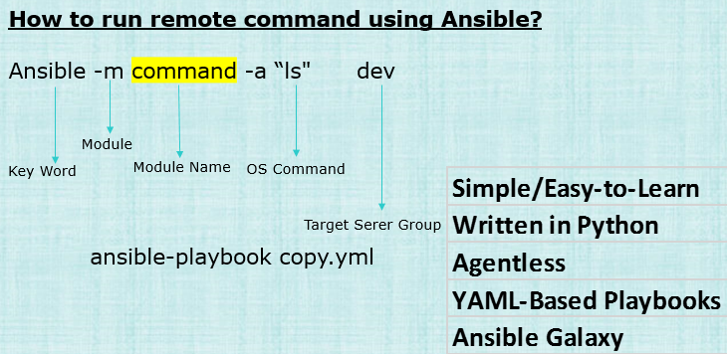
Create your own Automation tool
Ansible

Slide 45
Create your own Automation tool
Ansible
Why Ansible
It is a free open source application
Agent-less – No need for agent installation and management
Phython/yaml based
Highly flexible and configuration management of systems.
Large number of ready to use modules for system management
Custom modules can be added if needed
Configuration roll-back in case of error
Simple and human readable
Self documenting
Implement Sudo passwd, so that normal needs password to elevate his privileage.

Slide 46
Create your own Automation tool
Ansible concepts and architecture
There are two types of machines in the Ansible architecture: the control node and managed hosts.
Ansible software is installed on the control node and all of its components are maintained on it. The managed hosts are listed in a host inventory, a text file on the control node that includes a list of managed host names or IP addresses.
System administrators log into the control node and launch Ansible, providing it with a playbook and a target host to manage. Instead of a single system to control, a group of hosts or a wildcard can be specified

Slide 47
Create your own Automation tool
Ansible concepts and architecture
Ansible uses SSH as a network transport to communicate with the managed hosts. The modules referenced in the playbook are copied to the managed hosts. Then they are executed, in order, with the arguments specified in the playbook. Ansible users can write their own custom modules, if needed, but the core modules that come with Ansible can perform most system administration tasks.

Slide 48
Create your own Automation tool
Role and requirements for the control node
System administrators log in and initiate all Ansible operations from the control node. Ansible software is installed on the control node. Ansible configuration files are also maintained on the control node. Other names for the control node include Ansible host and control machine, but this course will consistently use the term “control node” for the machine that serves this role.
A machine acting as a control node must have Python 2.6 or 2.7 installed. This includes Linux, OS/X, and any BSD based Unix system. For Red Hat Enterprise Linux, the ansible package and its dependencies must be installed. Red Hat Enterprise Linux 6 or 7 will run Ansible software.
Windows is not supported for the control node at this time.

Slide 49
Create your own Automation tool
Role and requirements for the managed hosts
A managed host is a system that Ansible logs into, installs modules, and executes remote commands to perform configuration tasks. Other names for a managed host include managed node and remote node. This course will consistently use the term “managed host” for machines managed by Ansible.
Ansible uses SSH to communicate with managed hosts, so SSH must be installed and configured to allow incoming connections. Managed hosts must have Python 2.4 or later installed to run Ansible, which includes Red Hat Enterprise Linux 5, 6, and 7 hosts.
The python-simplejson package must also be installed on Red Hat Enterprise Linux 5 managed hosts. It is not required on Red Hat Enterprise Linux 6 and 7 managed hosts, since Python 2.5 (and newer versions) provide its functionality by default.

Slide 50
Create your own Automation tool
Ansible inventories
A host inventory defines which hosts Ansible manages. Hosts may belong to groups which are typically used to identify the hosts' role in the datacenter. A host can be a member of more than one group.
An Ansible static host inventory is defined in an INI-like text file, in which each section defines one group of hosts (a host group).
The default location for the host inventory file is /etc/ansible/hosts.

Slide 51
Create your own Automation tool
Ansible inventories
[webservers]
localhost ansible_connection=local
web1.example.com
web2.example.com:1234 ansible_connection=ssh ansible_user=ftaylor
[db-servers]
web1.example.com
db1.example.com
Host entries can also define how Ansible communicates with the managed host, including transport and user account information. In the previous example, SSH on web2.example.com is configured to listen on a non-standard port, port 1234. The account Ansible should use to log into that host is ftaylor.

Slide 52
Create your own Automation tool
DEPLOYING ANSIBLE
Ansible prerequisites
Control node
Unlike other configuration management utilities, such as Puppet and Chef, Ansible uses an agentless architecture. Ansible itself only needs to be installed on the host or hosts from which it will be run. Hosts which will be managed by Ansible do not need to have Ansible installed.
Ansible installation on the control node requires only that Python 2, version 2.6 or later be installed.

Slide 53
Create your own Automation tool
DEPLOYING ANSIBLE
[root@controlnode ~]# yum list installed python
Loaded plugins: langpacks, search-disabled-repos
Installed Packages
python.x86_64 2.7.5-34.el7 installed
Managed hosts
Managed hosts do not need to have any special Ansible agent installed. They do need to have Python 2, version 2.4 or later installed. If the version of Python installed on the managed host is earlier than Python 2.5, then it must also have the python-simplejson package installed.

Slide 54
Create your own Automation tool
DEPLOYING ANSIBLE
The Ansible control node communicates with managed hosts over the network. Multiple options are available, but an SSH connection is used by default. Ansible normally connects to the managed host by using the same user name as the one running Ansible on the control node.
To ensure security, SSH sessions require authentication at the initiation of each connection.
SSH key-based authentication
Users can authenticate ssh logins without a password by using public key authentication. Ssh allows users to authenticate using a private-public key scheme. This means that two keys aregenerated, a private key and a public key.

Slide 55
Create your own Automation tool
DEPLOYING ANSIBLE
The private key file is used as the authentication credential and, like a password, must be kept secret and secure. The public key is copied to systems the user wants to log in to and is used to verify the private key. The public key does not need to be secret.
Key generation is performed using the ssh-keygen command.
This generates the private key, ~/.ssh/id_rsa, and the public key, ~/.ssh/id_rsa.pub.

Slide 56
Create your own Automation tool
Configuring Ansible
The behavior of an Ansible installation can be customized by modifying settings housed in
Ansible's configuration file (/etc/ansible/ansible.cfg).
The behavior of an Ansible installation can be customized by modifying settings housed in
Ansible's configuration file (/etc/ansible/ansible.cfg).
privilege_escalation section in the ansible.cfg configuration file by adding the following entry.
[privilege_escalation]
Enable privilege escalation by adding the become setting and configuring it as True.
become=True

Slide 57
Create your own Automation tool
Configuring Ansible
Set the privilege escalation to use sudo by adding the become_method setting and configuring it as sudo.
become_method=sudo
Set the privilege escalation user by adding the become_user setting and configuring it as root.
become_user=root
Enable password prompting during privilege escalation by adding the become_ask_pass setting and configuring it as True.
become_ask_pass=True

Slide 58
Create your own Automation tool
IMPLEMENTING PLAYBOOKS
Goal: Write Ansible plays and execute a playbook.
Objectives
Write YAML files.
Implement Ansible playbooks.
Write and execute a playbook.

Slide 59
Create your own Automation tool
IMPLEMENTING PLAYBOOKS
Introduction to YAMLAnsible playbooks are written using the YAML Ain’t Markup Language (YAML) language. Therefore, it is necessary to understand the basics of YAML syntax to compose an Ansible playbook.
YAML was designed primarily for the representation of data structures such as lists and associative arrays in an easy to write, human-readable format.
YAML files optionally begin with a three dash start of document marker and are optionally terminated with a three dot end of file marker.

Slide 60
Create your own Automation tool
IMPLEMENTING PLAYBOOKS
Using YAML in Ansible playbooks
Start and end of file markers
YAML files are initiated with a beginning of document marker made up of three dashes. Playbooks can be initiated with this line. However, it is optional and does not affect the execution of a playbook.
---
...output omitted...
...

Slide 61
Create your own Automation tool
IMPLEMENTING PLAYBOOKS
---
- hosts: dev
become: true
become_user: root
tasks:
- name: run the script
script: /home/sverma/ansible/scr.sh
when: ansible_distribution == "RedHat" and ansible_distribution_major_version == '7'

Slide 62
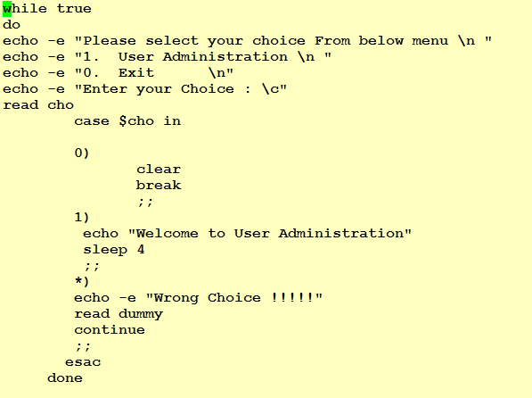
Create your own Automation tool
User Administration

Slide 63
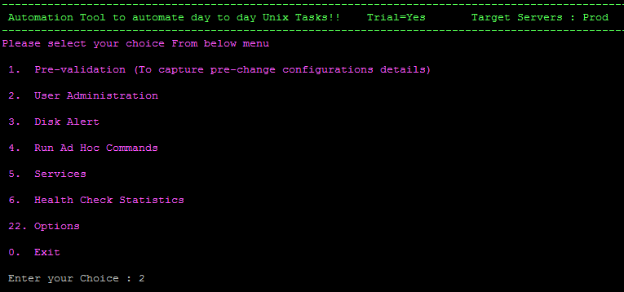
Create your own Automation tool
User Administration

Slide 64
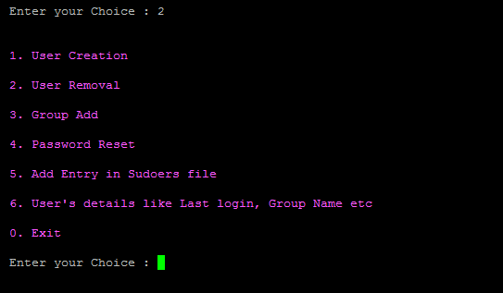
Create your own Automation tool
User Administration
Now next to add the below sub options in User Administration tab

Slide 65
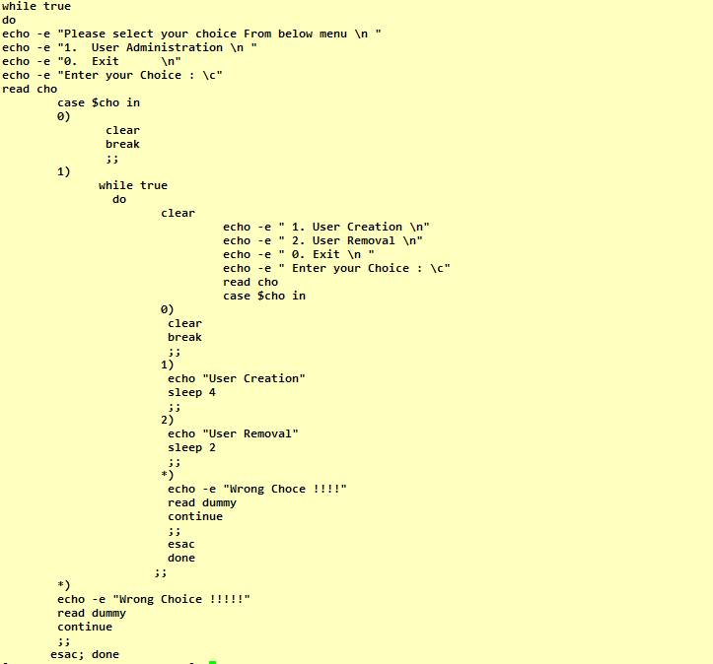

Slide 66
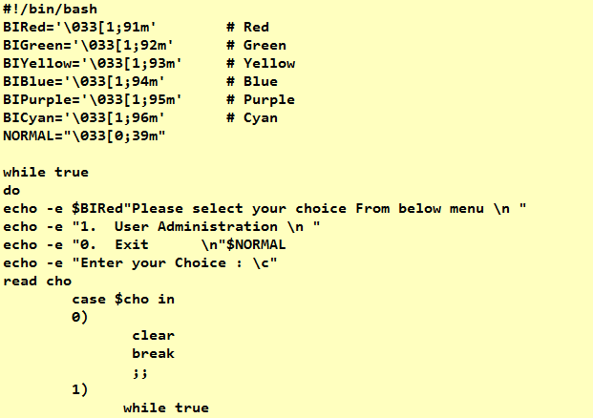
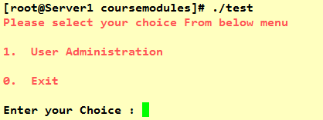
Create your own Automation tool
User Administration
Adding color to the scripts

Slide 67
Create your own Automation tool
User Creation via Ansible Playbook & Shell Scripting
Below is the command which can be used to create the User Account manually on the server.
useradd –u <uid> -m –d /home/accounts/steve –G accounts –c “Oracle DB” –s “/bin/bash” user name

Slide 68
Create your own Automation tool
User Creation via Ansible Playbook & Shell Scripting
The /etc/passwd file contains a colon-separated list of fields about each user.
The fields are as follows:
username
encrypted password (which you obviously can't see)
userid
user's group id
full name of the user
user's home directory
login shell

Slide 69
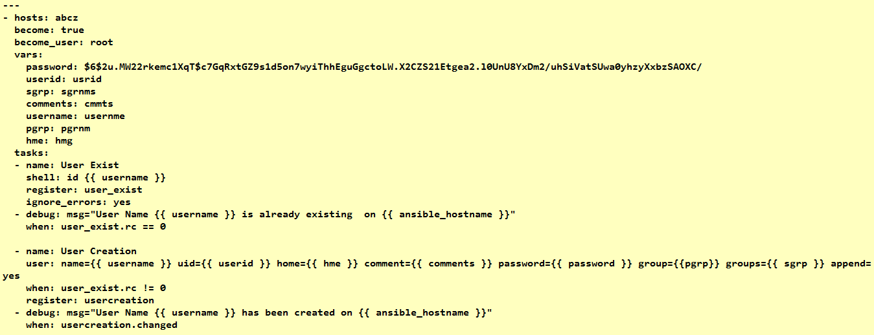
Create your own Automation tool
Create a playbook for the User Creation as shown below

Slide 70
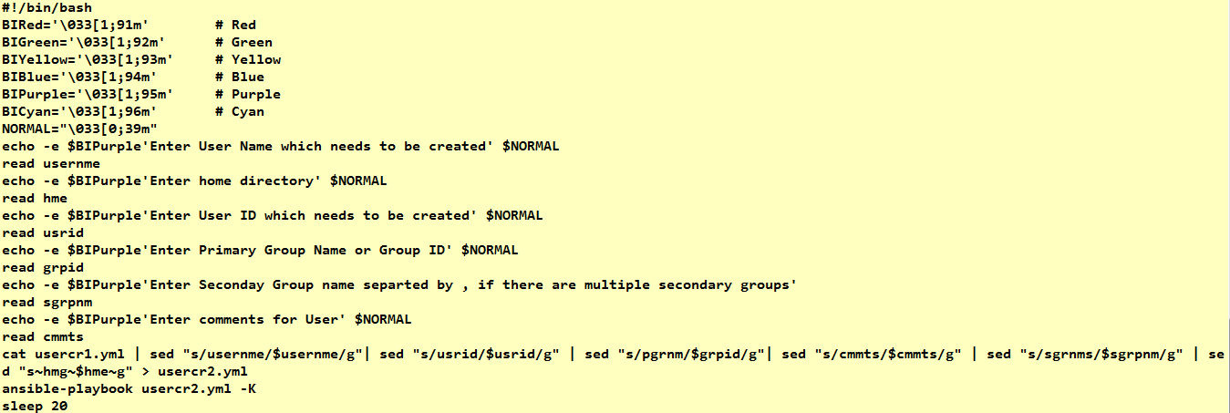
Create your own Automation tool
Create a shell script for the User Creation as shown below

Slide 71
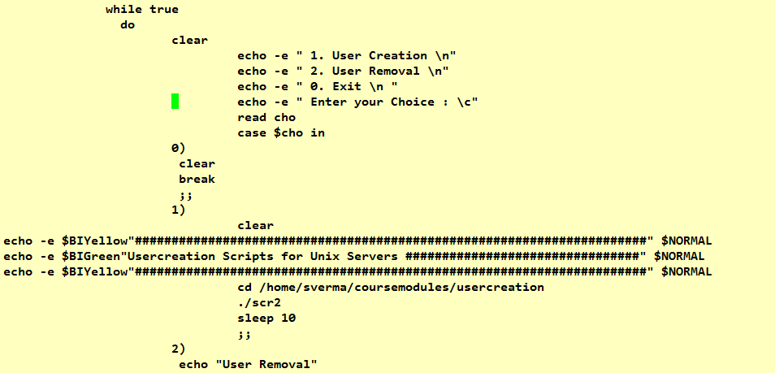
Create your own Automation tool
How to run this via Automation tool

Slide 72
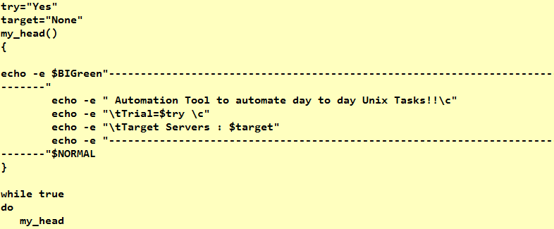
Create your own Automation tool
Headline and selecting target servers

Slide 73
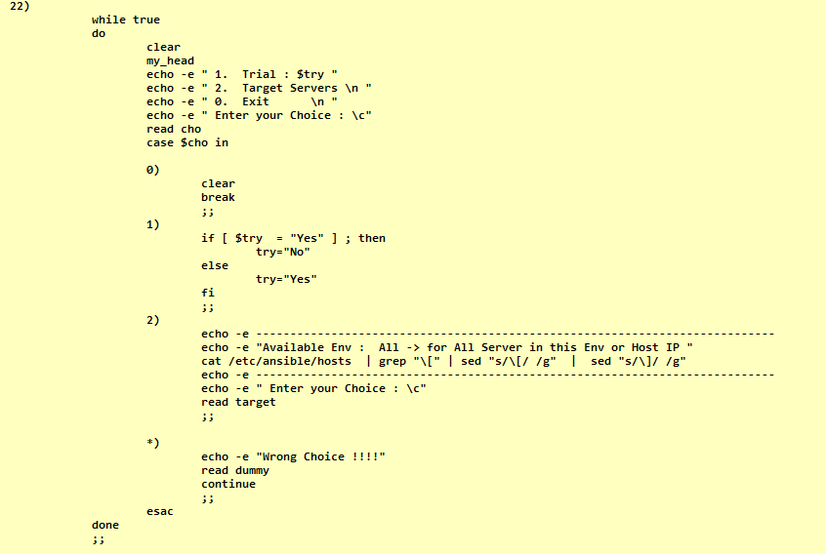
Create your own Automation tool
Headline and slecting target servers

Slide 74
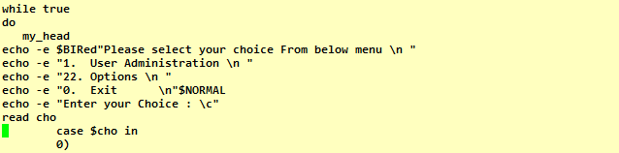
Create your own Automation tool
Headline and selecting target servers

Slide 75
Create your own Automation tool
Health Check Statistics Report
Memory Utilization
CPU Utilization
Overall I/O Activities
Reports run queue and load average
Report network statistics
Top CPU Consuming Process
Top Memory Consuming Process
Shared Memory Statistic

Slide 76
Links to Download RHEL/VMware
Where to download RHEL ISO Image
https://access.redhat.com/downloads/
Where to download VMware Workstation
https://my.vmware.com/web/vmware/downloads

Slide 77
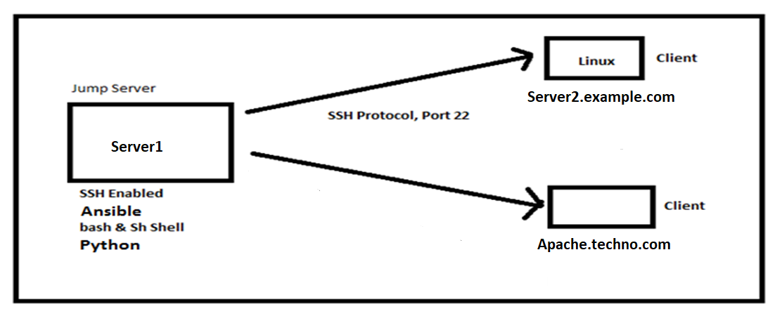
Create your own Automation tool
Setup

Slide 78
Linux Online Training Classes
Course Name: Complete Linux Administration
Duration: 40-44 hours
Mode of Teaching: English via Skype only (Anyone from world wide can join it)
Skype ID : shikhar690
Instructor : 12 Years of IT Industry Experience ( Also Instructor in Udemy and many courses are already live there)
+91-9999668250

Slide 79
Ansible Online Training Classes
Course Name: Ansible Administration
Duration: 20-24 hours
Mode of Teaching: English via Skype only (Anyone can join world wide)
Skype ID : shikhar690
Instructor : 12 Years of IT Industry Experience ( Also Instructor in Udemy and many courses are already live there)
Whatsapp Number: +91-9999668250

